Slide 1
Kambi Group plc
Q1 Report 2019
April 2019, Stockholm

Slide 2
Agenda
Kambi overview & highlights
Financial update
Kambi initiatives
Customer signing
Events after Q1
Summary
Q&A

Slide 3
Kambi at a glance
Leading B2B provider of premium sports betting services
End-to-end sports betting services
Sports betting value chain
B2B suppliers
B2C operators
End user
Technical platform
Odds & trading
Real-time
Sports data
Operators
Risk management
User interfaces
A global organisation
690
employees
Australia | Malta | Philippines | Romania | Sweden | U.K. | U.S.
Notes:
692 for Q3

Slide 4
Kambi at a glance
Leading B2B provider of premium sports betting services
End-to-end sports betting services
A global organisation
690
employees
Australia | Malta | Philippines | Romania | Sweden | U.K. | U.S.
Notes:
692 for Q3

Slide 5
Kambi at a glance
Leading B2B provider of premium sports betting services
End-to-end sports betting services
A global organisation
690
employees
Australia | Malta | Philippines | Romania | Sweden | U.K. | U.S.
Notes:
692 for Q3

Slide 6
Kambi at a glance
Leading B2B provider of premium sports betting services
Business model
25 Operators
Kambi mainly operates on a revenue share model, thus Kambi’s growth is dependent on its operators’ success
The foundation of the strategy is based on scalability and the majority of its cost base is fixed
Continuous investment into proprietary technology to maintain its market leadership
Highest level of corporate probity and integrity
Notes:
Add mybet?

Slide 7
Highlights
42%
Solid financial performance with 14% revenue growth
Strong operator turnover growth of 42% and operator trading margin of 8.5%
Launched on-property Sportsbooks in Atlantic City, Pittsburgh and Philadelphia
Signed with Greenwood Gaming & Entertainment, owner of Parx Casino
Received full licence in Mississippi and an interim licence in Pennsylvania
operator turnover growth

Slide 8
Financial headlines
2018
2017

Slide 9
Operator trading analysis
Kambi operators' turnover and trading margin
Notes:
Circle Q2, Q3

Slide 10
Kambi revenue conversion
Q4 2018 vs Q4 2017
Notes:
*Other includes the impact of renewed customer contracts, volume-related commission tiers and fixed revenues

Slide 11
Income statement
€m | Q4 2018 | Q4 2017 | FY 2018 | FY 2017
Revenue | 21.7 | 19.0 | 76.2 | 62.1
Operating expenses | 17.5 | 14.0 | 63.5 | 54.4
Operating result | 4.2 | 5.0 | 12.7 | 7.7
Result after tax | 3.3 | 3.9 | 9.8 | 5.9

Slide 12
Cash flow
€ ‘000

Slide 13
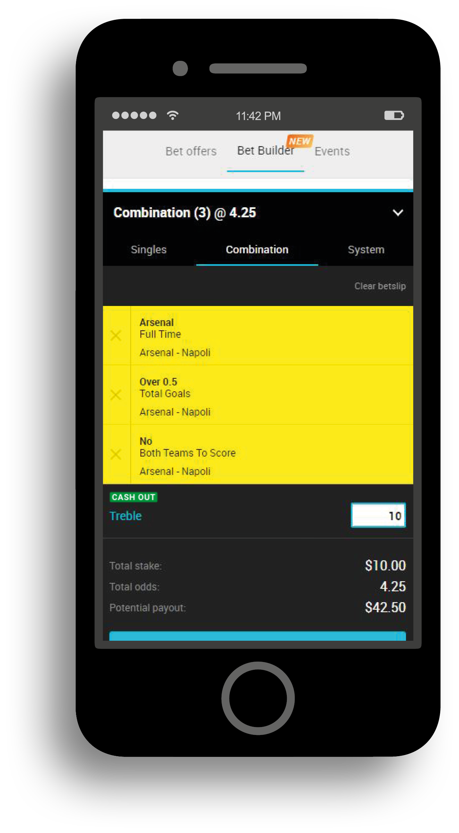
Kambi initiatives
Subhead
Bullet 1
Bullet 2

Slide 14
Kambi initiatives
Subhead
Bullet 1
Bullet 2

Slide 15
Kambi signs Mohegan Sun
Subhead
Bullet 1
Bullet 2

Slide 16
Greenwood Gaming & Entertainment
Bullet 1
Bullet 2

Slide 17
Q1 Events
Bullet 1
Bullet 2

Slide 18
Summary

Slide 19
Q&A

Slide 20
Thank you

